Slide 1
Title Sub-title
Here is where your presentation begins

Slide 2
Presentation Title
Title
Title
01
02
Title
Title
03
04
You can describe the topic of the section here
You can describe the topic of the section here
You can describe the topic of the section here
You can describe the topic of the section here

Slide 3
WHOA!
This can be the part of the presentation where you introduce yourself, write your email…

Slide 4
01
INTRODUCTION
You can enter a subtitle here if you need it

Slide 5
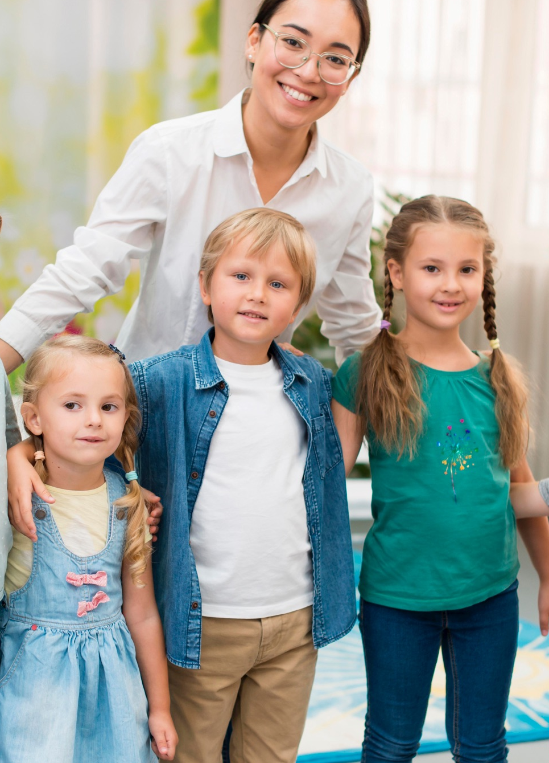
SUMMARY OF THE YEAR
Do you know what helps you make your point clear? Lists like this one:
They’re simple
You can organize your ideas clearly
You’ll never forget to buy milk!
And the most important thing: the audience won’t miss the point of your presentation

Slide 6
THIS YEAR'S HIGHLIGHTS
MERCURY
VENUS
Mercury is the closest planet to the Sun and the smallest one in the Solar System—it’s only a bit larger than the Moon
Venus has a beautiful name and is the second planet from the Sun. It’s hot and has a poisonous atmosphere

Slide 7
graduating classes
MERCURY
VENUS
MARS
A
B
C
It’s the closest planet to the Sun and the smallest one in the Solar System
Venus has a beautiful name and is the second planet from the Sun
Despite being red, Mars is actually a cold place. It’s full of iron oxide dust

Slide 8
SPECIAL AWARDS
MARS
VENUS
JUPITER
SATURN
Mars is actually a very cold place in the Solar System
Venus is extremely hot, even more than Mercury
Jupiter is the biggest planet in the Solar System
Saturn is a gas giant and has several rings

Slide 9
SPECIAL HONORS
MARS
VENUS
NEPTUNE
MERCURY
SATURN
JUPITER
Despite being red, Mars is very cold
Venus is extremely hot, even more than Mercury
Neptune is the farthest from the Sun
Mercury is the closest planet to the Sun
Saturn is a gas giant with several rings
Jupiter is the biggest planet of them all

Slide 10
4,498,300,000
Big numbers catch your audience’s attention

Slide 11
AWESOME WORDS

Slide 12
—SOMEONE FAMOUS
“This is a quote, words full of wisdom that someone important said and can make the reader get inspired.”

Slide 13
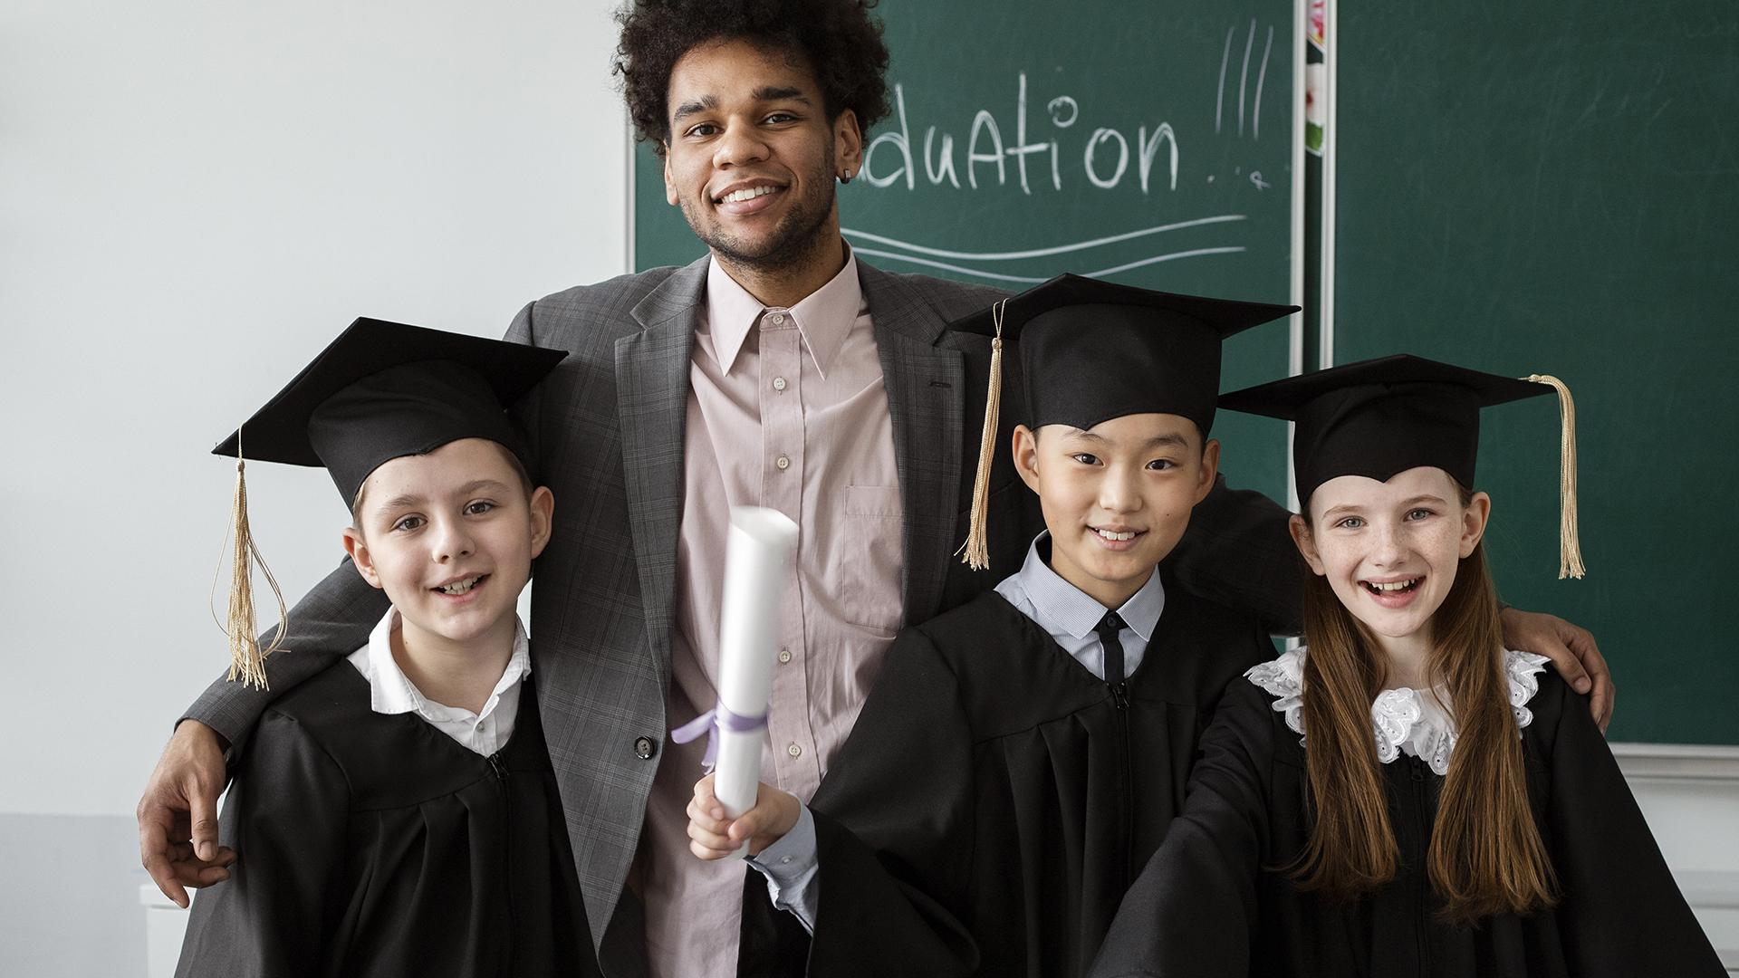
A PICTURE IS WORTH A THOUSAND WORDS

Slide 14
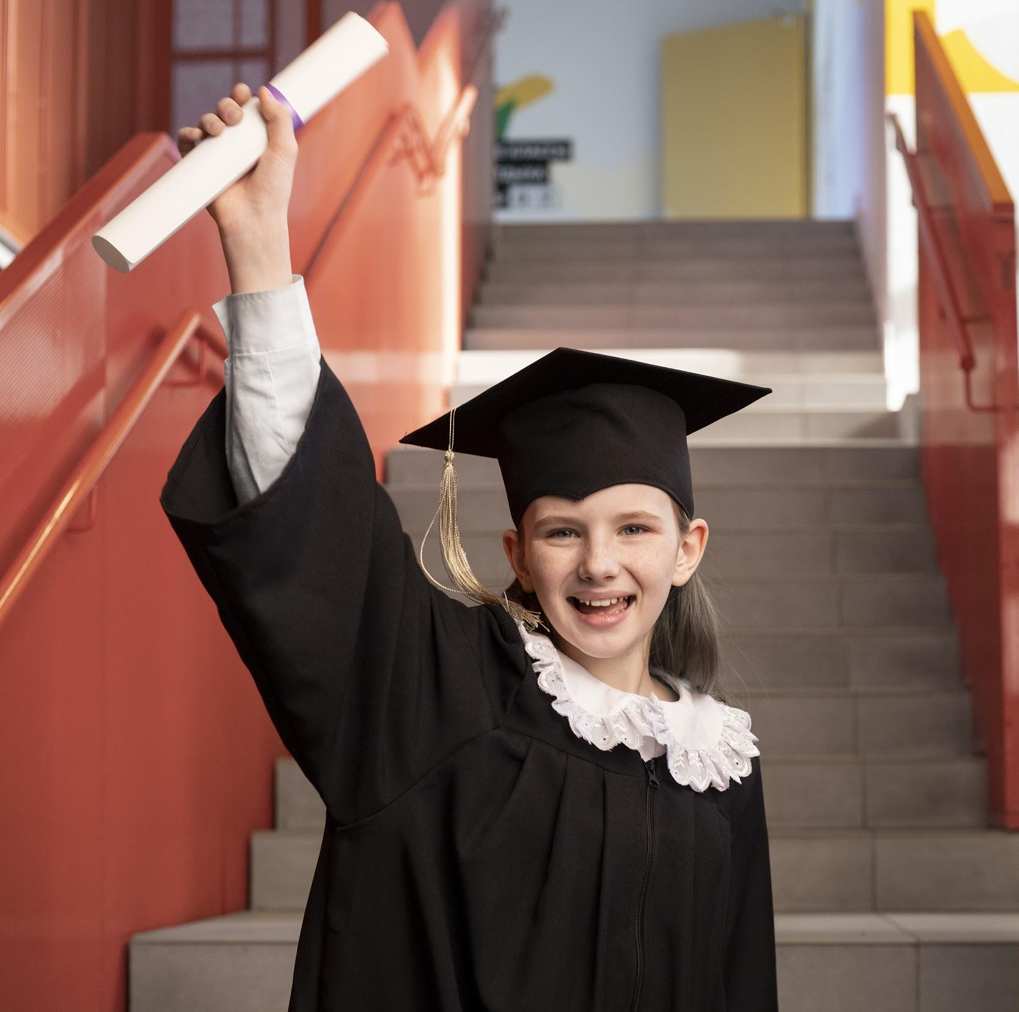
A PICTURE ALWAYS REINFORCES THE CONCEPT
Images reveal large amounts of data, so remember: use an image instead of a long text. Your audience will appreciate it for sure

Slide 15
9h 55m 23s
333,000
386,000 km
Jupiter's rotation period
The Sun’s mass compared to Earth’s
Distance between Earth and the Moon

Slide 16
POPULAR ACTIVITIES
30%
10%
70%
MERCURY
VENUS
MARS
It’s the closest planet to the Sun and the smallest one in the Solar System
Venus has a beautiful name and is the second planet from the Sun
Despite being red, Mars is actually a cold place. It’s full of iron oxide dust

Slide 17
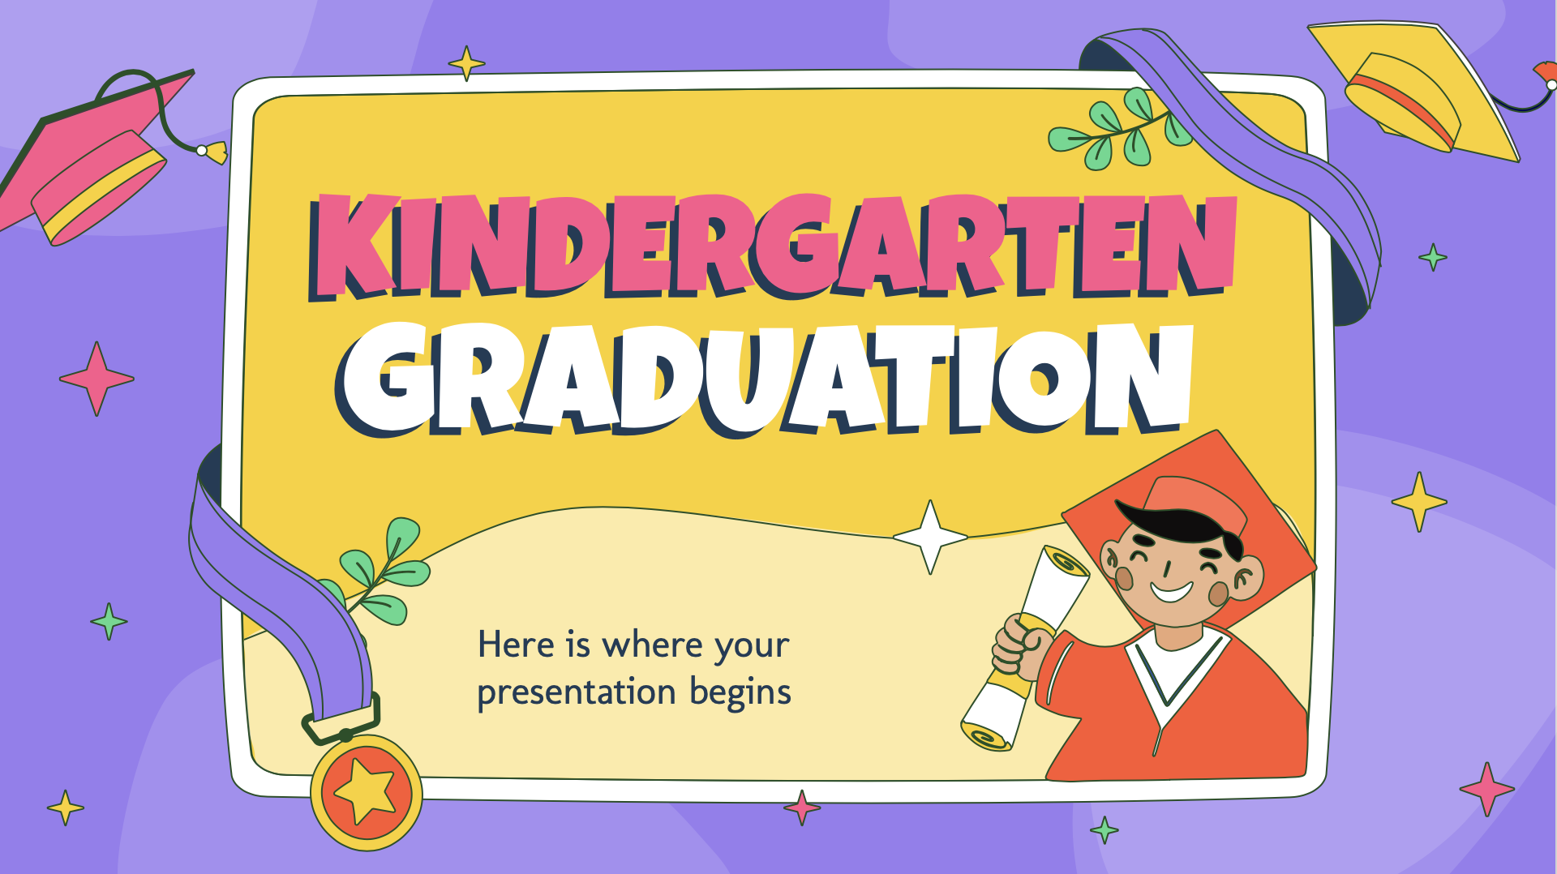
COMPUTER MOCKUP
You can replace the image on the screen with your own work. Just right-click on it and select “Replace image”

Slide 18
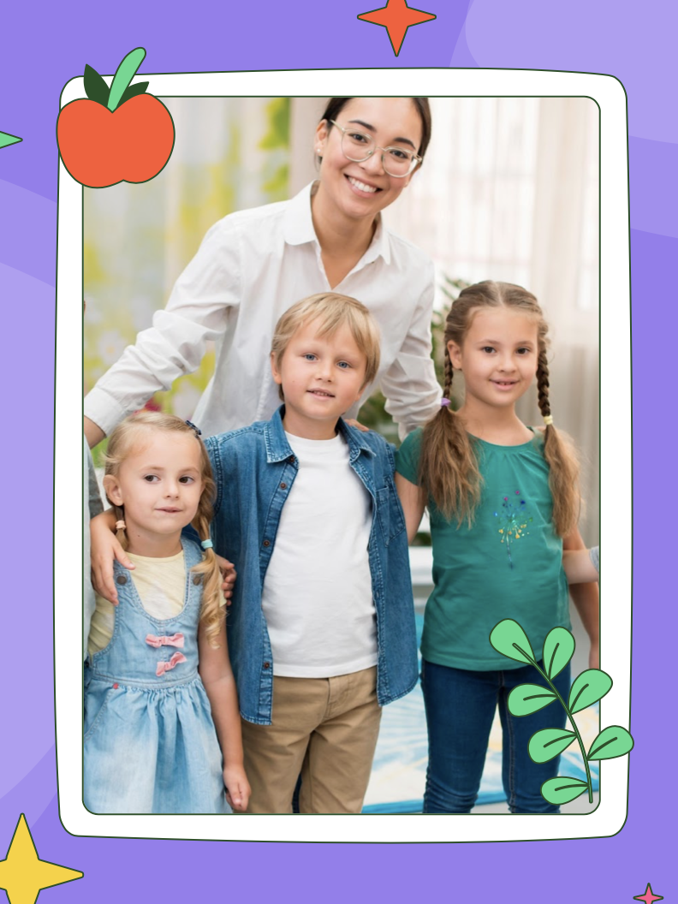
TABLET MOCKUP
You can replace the image on the screen with your own work. Just right-click on it and select “Replace image”

Slide 19
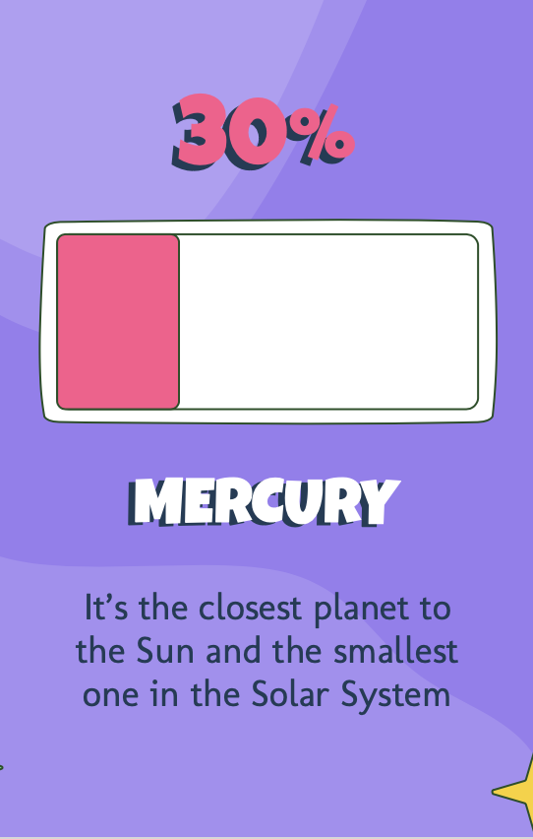
PHONE MOCKUP
You can replace the image on the screen with your own work. Just right-click on it and select “Replace image”

Slide 20
ALL OUR kindergartens
VENUS
Venus has a beautiful name, but also high temperatures
MERCURY
Mercury is the smallest planet in the Solar System
MARS
Despite being red, Mars is actually a very cold place

Slide 21
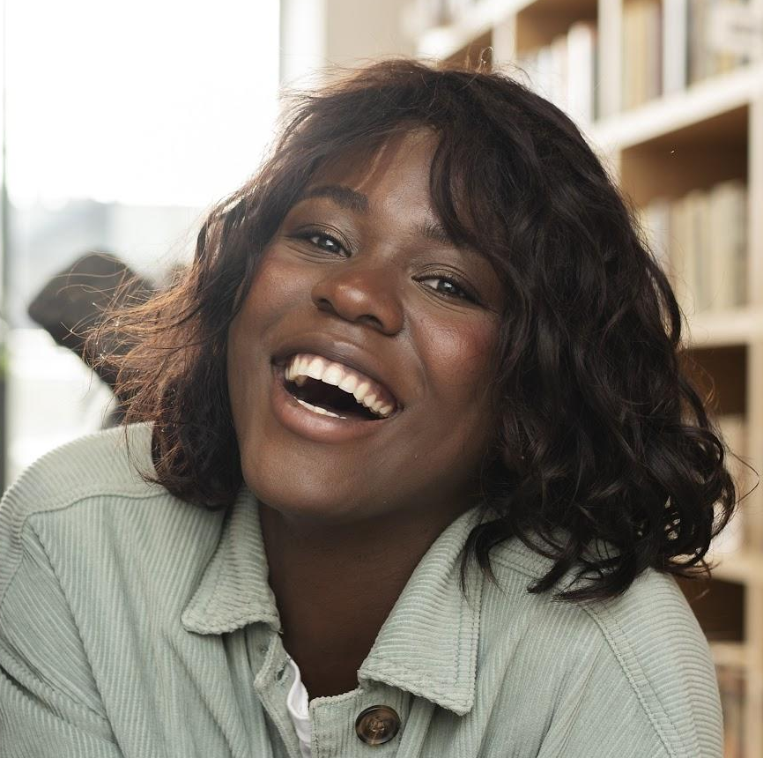

THE Teachers
SOFIA HILLS
CHRIS HARRIS
You can speak a bit about this person here
You can speak a bit about this person here

Slide 22
YEARLY EVOLUTION
01
02
03
04
05
06
Neptune is the farthest planet from the Sun
Despite being red, Mars is actually a cold place
Venus is the second planet from the Sun
Mercury is the smallest planet in the Solar System
Saturn is composed mostly of hydrogen and helium
Jupiter is the biggest planet in the Solar System

Slide 23
COURSE COMPOSITION
MARS
VENUS
Mars is actually a very cold place
Venus has extremely high temperatures
MERCURY
SATURN
It’s the smallest planet in the Solar System
Saturn is a gas giant and has several rings

Slide 24
Calendar of activities
MON | TUE | WED | THU | FRI
Despite being red, Mars is actually a cold place | Jupiter is the biggest planet in the Solar System | Saturn is a gas giant and has several rings | Neptune is the farthest planet from the Sun | Earth is the third planet from the Sun and has life

Slide 25
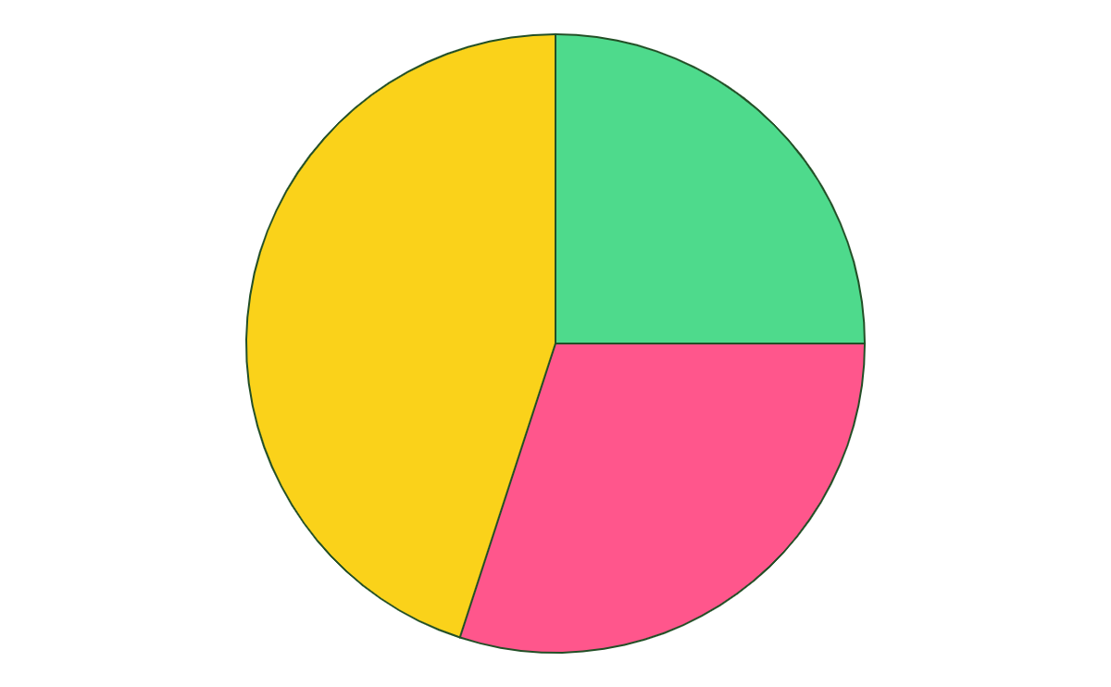
MAIN ACTIVITIES
25%
MUSIC
45%
Mercury is the closest planet to the Sun
DRAWING
Saturn is a gas giant and has rings
30%
MATH
Venus is the second planet from the Sun
Follow the link in the graph to modify its data and then paste the new one here. For more info, click here

Slide 26
02
SPEAKERS
You can enter a subtitle here if you need it

Slide 27
CERTIFICATE
of achievement
TIMMY JIMMY DOE
Mercury is the closest planet to the Sun and the smallest one in the Solar System—it’s only a bit larger than the Moon
John Smith
Jenna Doe
Teacher
Principal

Slide 28
GRADUATION POEM
TITLE OF THE POEM
Jupiter is a gas giant And a big planet indeed I’ll board my rocket To go there at full speed Earth is our planet It harbors lots of life It’s a great place for living With my kids and my wife

Slide 29
03
AWARDS
You can enter a subtitle here if you need it

Slide 30
GRADUATION SCHEDULE
8:00 | 8:30 | 9:30 | 10:30
START | SUMMARY | AWARDS | APPETIZERS
Despite being red, Mars is actually a cold place | Jupiter is the biggest planet in the Solar System | Saturn is a gas giant and has several rings | Neptune is the farthest planet from the Sun

Slide 31
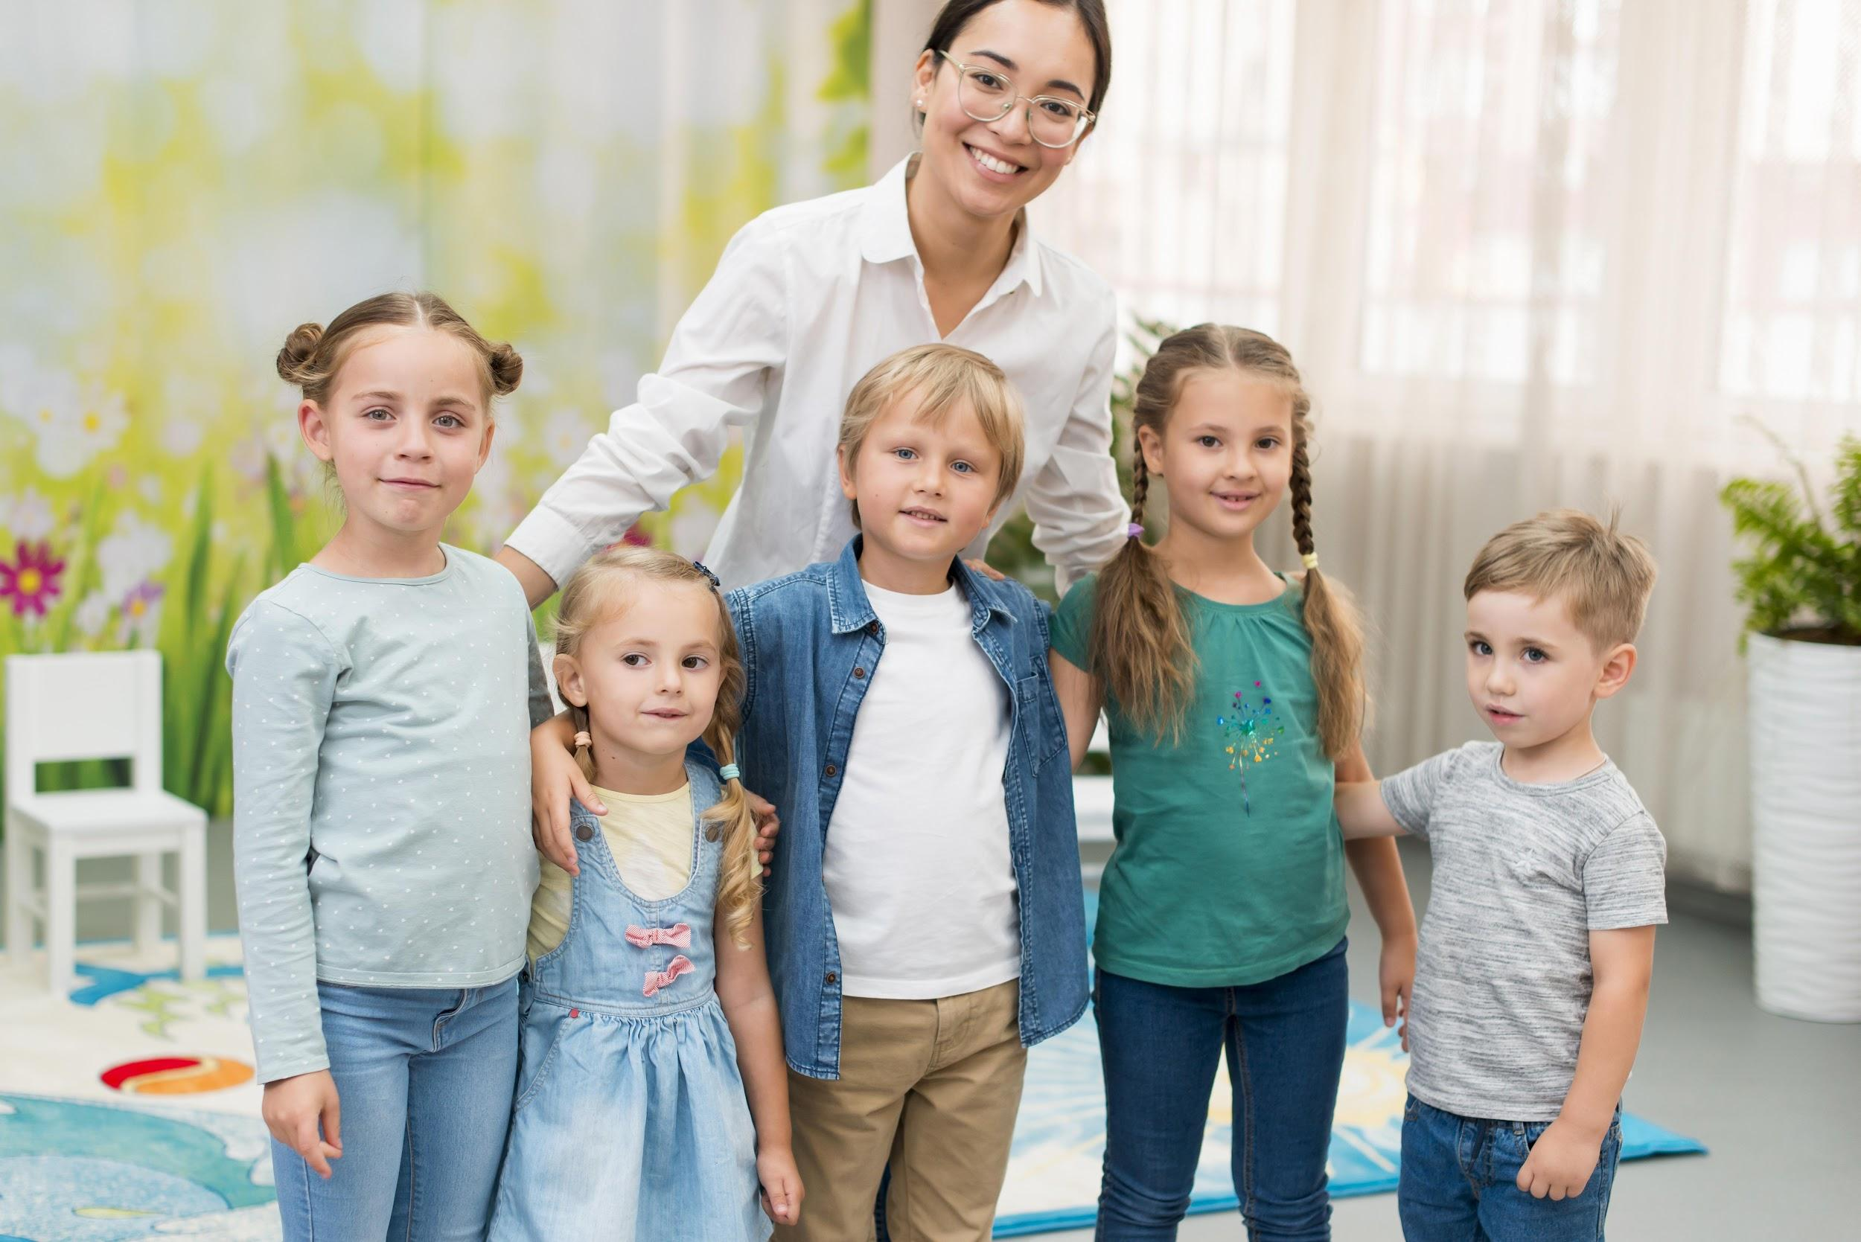
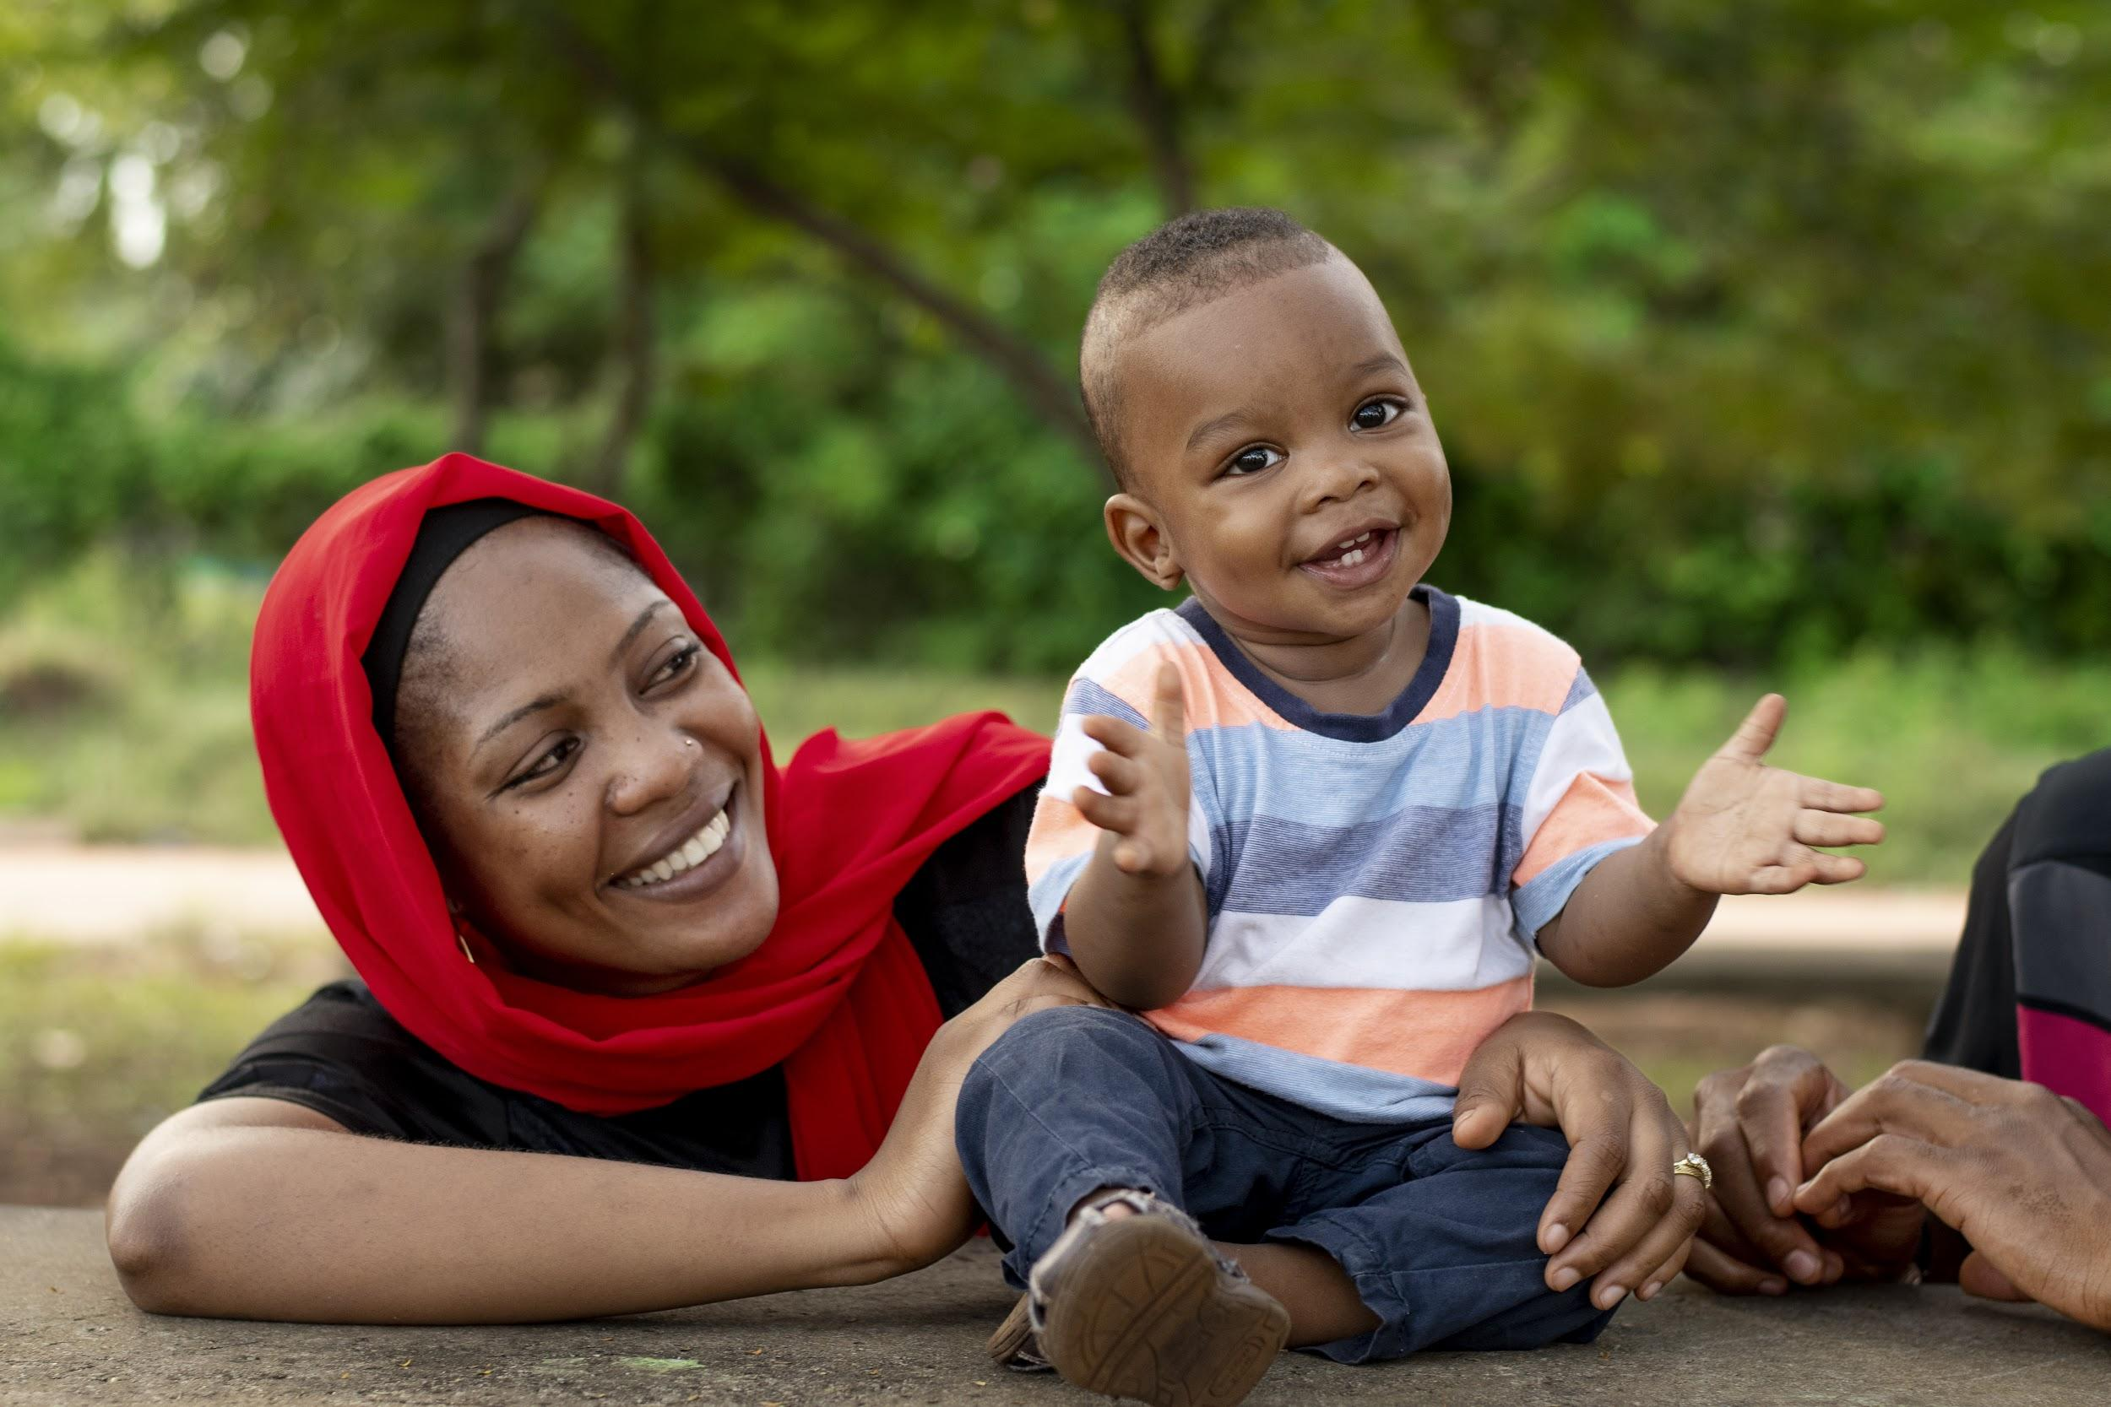
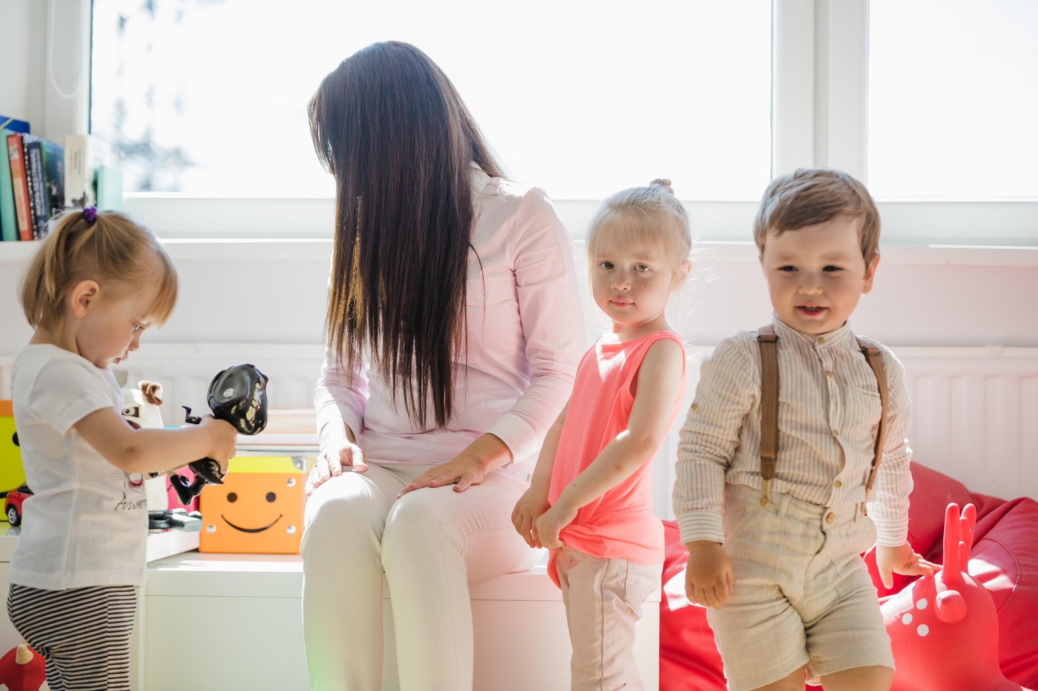
HALL OF FAME
HELENA DOE
JENNA CLARK
ANNETTE MILL
RICHARD DOE
CLAUDIA BROWN
TIMMY JIMMY
JOHN DOE
RACHEL WEST

Slide 32
Award for the best gradeS
TIMMY JIMMY
Mercury is the closest planet to the Sun and the smallest one in the Solar System—it’s only a bit larger than the Moon
Angeles Orozco
Miriam Cruz
Principal
Teacher

Slide 33
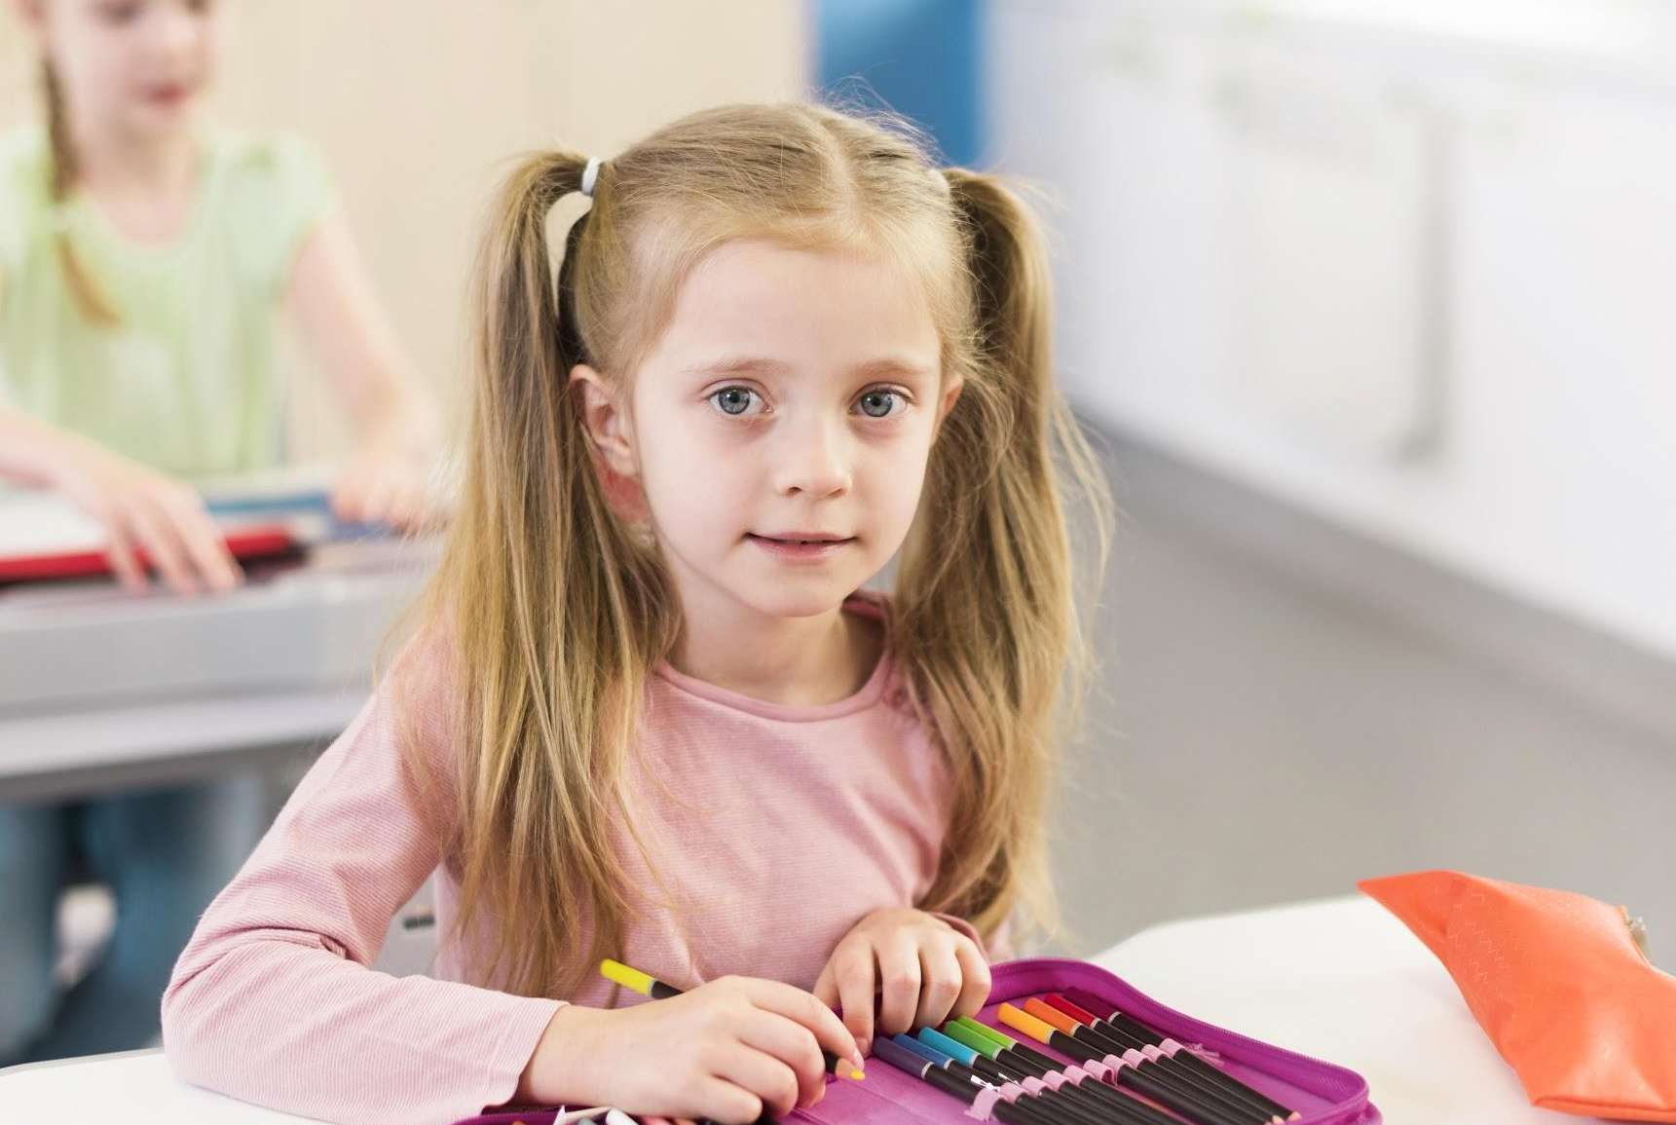
DISTINCTION WITH HONORS
HELENA DOE
Class representative
“Mercury is the closest planet to the Sun and the smallest one in the Solar System—in fact, it’s only a bit larger than Earth’s Moon”

Slide 34
THANKS
Do you have any questions?
yourmail@gmail.com
yourwebsite.com
Please keep this slide for attribution

